Slide 1
how to Create a user role in Magento 2.

Slide 2
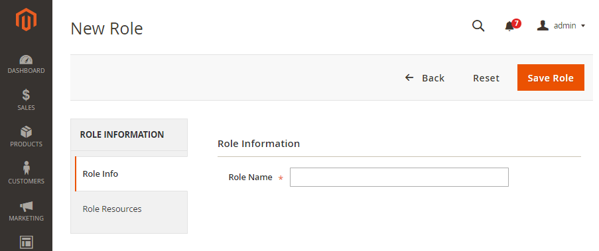
To define a role in Magento 2
On the Admin panel, click System. In the Permissions section, select User Roles.
In the upper-right corner, click Add New Role button

Slide 3
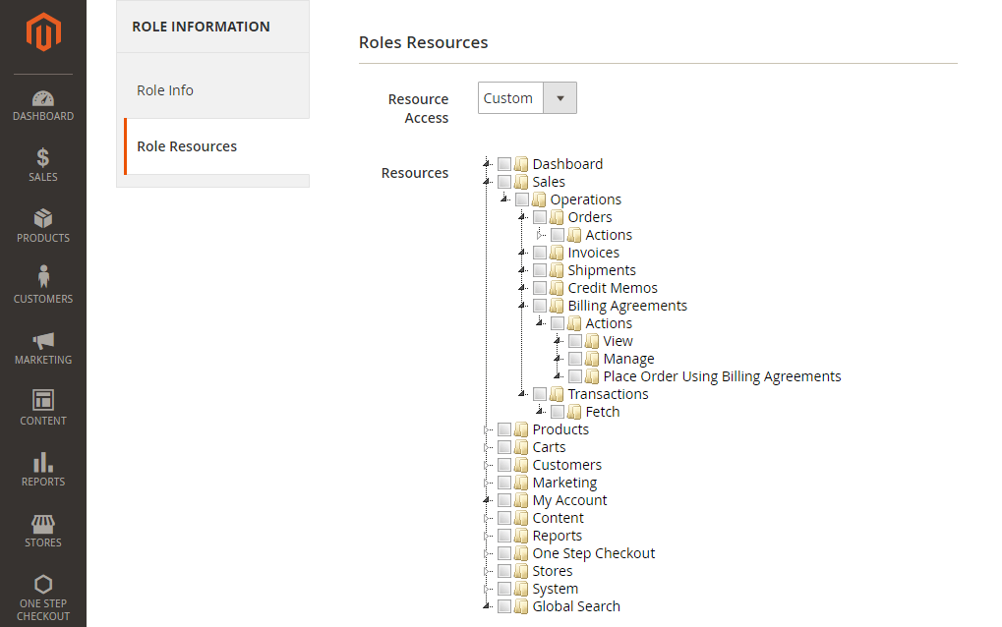
To define a role in Magento 2
In the Role Information field, enter a descriptive Role Name.
In the panel on the left, choose Role Resources

Slide 4
To define a role in Magento 2
In the Resource Access field, do the following
Set to Custom, then mark the checkbox of each website and view to which the role is to have permission to access.
Set to All if you want to mark all the checkbox
When complete, click Save Role.

Slide 5
How to manage customers and customers group in Magento 2
Step 1: Add New Customer
Step 2: Add New Customer Group
Step 1: Add New Customer
You need your Magento 2 admin panel to add a new customer to your store. Navigate to Customers > All Customers

Slide 6
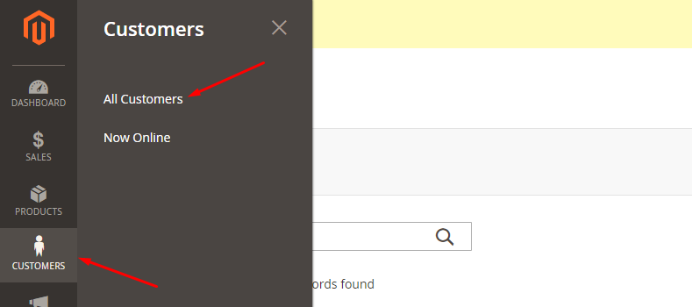

Slide 7
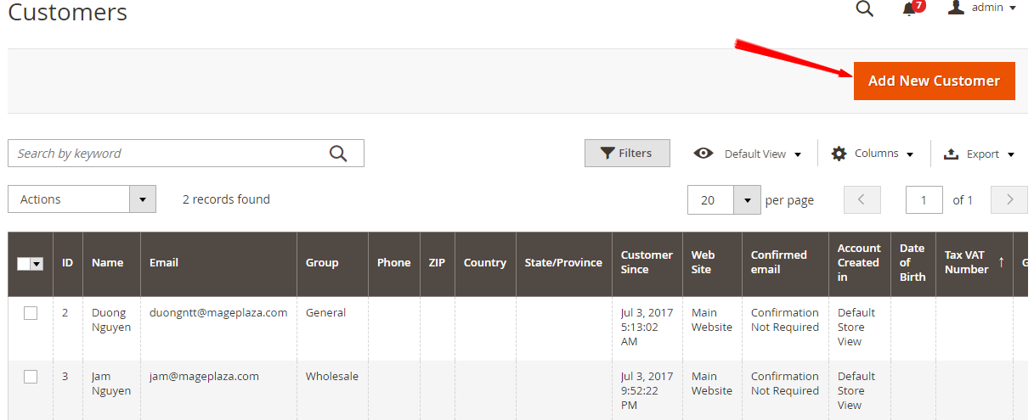
Here is where all customers on your website are displayed on the screen. At the top right corner of the page, you need to click on the Add New Customer button.

Slide 8
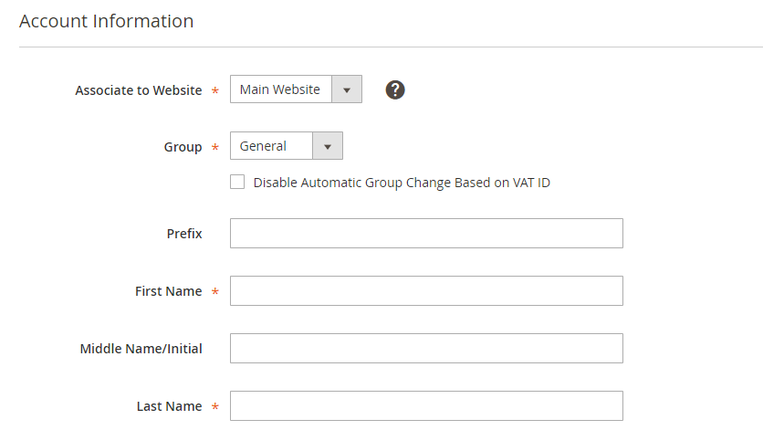
Now you have to fill in the customer information in the appropriate fields in the Account Information tab.

Slide 9
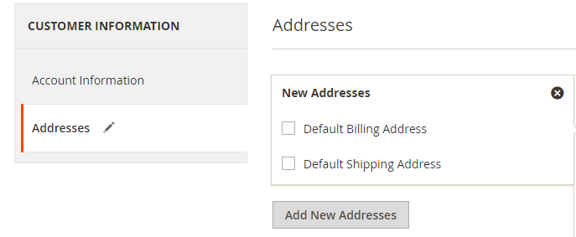
In addition, you also can add billing and shipping addresses for the customer in the Addresses tab.

Slide 10
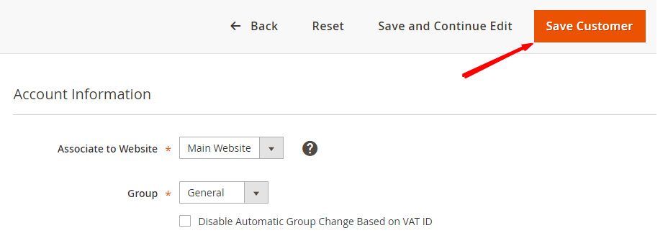
Then, clicking on the Save Customer button to complete.

Slide 11
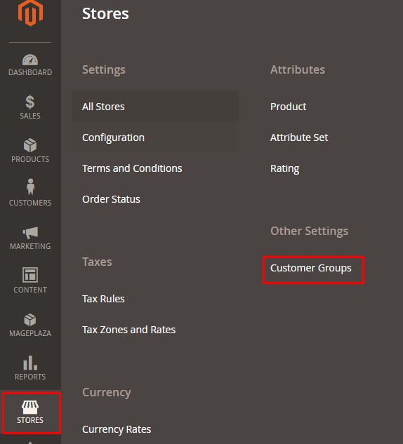
Step 2: Add New Customer Group
The Customer Group section is separated from the Customers menu and located in the Stores menu.
Navigate to Stores > Other setting > Customer Groups

Slide 12
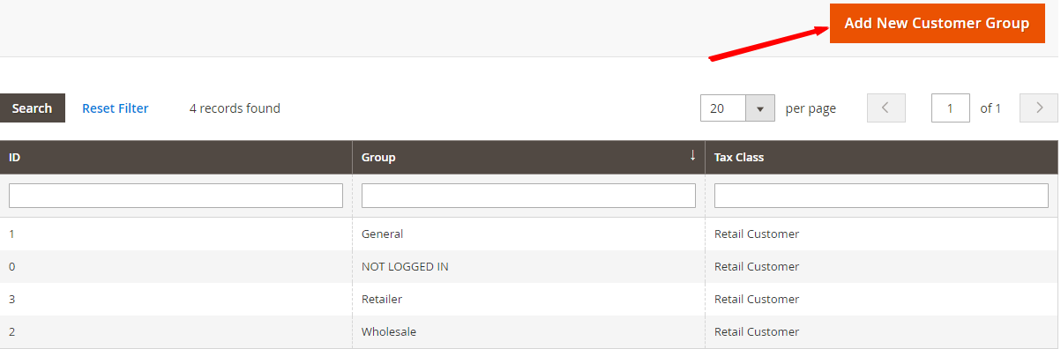
After selecting Customer Groups, on the screen, all customer groups will be displayed.
To create a new group, click on the button Add New Customer Group located on the top right corner of the screen.

Slide 13
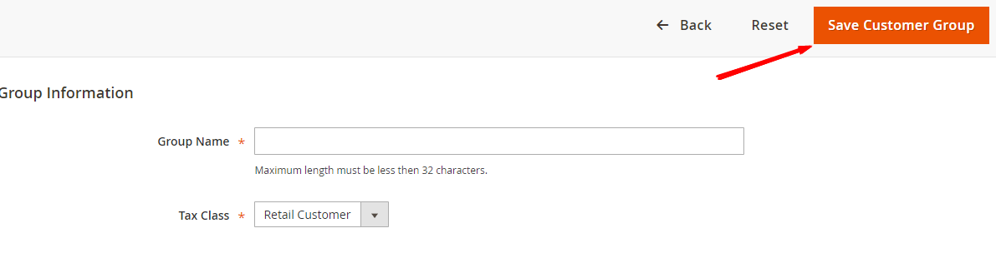
Next, you have to name the group (maximum length must be less than 32 character) and select Tax Class for it.
After all, click on the button Save Customer Group to create this group.

